Slide 1
Agentic AI Hackathon: A System for Explainable Traffic Congestion Analysis

Slide 2



Name of the team: SKYMINDS
Details of Team members
TEAM MEMBER NAME | Recent Passport Photo | Email ID | Phone number [WhatsApp]
Avani Manoria |  | avanimanoria.@gmail.com | 9109471971
Drithi Girish |  | drithi3107@gmail.com | 7760468929
Pavithra Vijaykumar |  | vpavithra1129@gmail.com | 8971120575

Slide 3
Problem statement
Modern traffic management systems can detect traffic congestion but often fail to explain the reasons behind it. Traffic operators usually receive congestion alerts without sufficient information about contributing factors such as traffic volume changes, peak hours, road incidents, or weather conditions. This lack of explainability reduces trust in AI-based systems and makes effective decision-making difficult.
Therefore, there is a need for an explainable, agent-based AI system that analyzes traffic data, identifies congestion causes, and provides clear, human-readable explanations using traffic engineering knowledge to improve transparency, trust, and usability in traffic congestion analysis.

Slide 4
Proposed solution
We propose an Agentic AI-based explainable traffic congestion analysis system.
•The system uses multiple AI agents to analyze traffic data and identify congestion.
•A Traffic Data Analysis Agent detects congestion patterns from traffic volume, speed, and time.
•A Congestion Cause Analysis Agent identifies reasons such as peak hours, accidents, and weather.
•An Explainable Insight Assistant converts technical results into simple, human-readable explanations.
•The system is built using LangFlow, IBM Granite model, and RAG with traffic engineering knowledge.
•This approach improves transparency, trust, and decision-making for traffic operators.

Slide 5
Need of project
•Existing traffic systems detect congestion but do not explain the causes
•Lack of explanation reduces trust and effective decision-making
•Traffic operators need clear, understandable insights, not just alerts
•An explainable AI system helps analyze, explain, and manage congestion better

Slide 6
End user of project
Traffic control and traffic management authorities
Smart city transportation departments
Urban planners and road safety officials
Traffic monitoring and control centers

Slide 7
Technology Used
Langflow platform
Langflow component name – Agent , Chat input , Chat output
IBM Grainte model - for eg – ibm-granite-3-2-8b
IBM Cloud
RAG
IBM Watsonx.ai
Watsonx

Slide 8
Novelty and Uniqueness
Multi-agent AI system with Traffic Data Analyzer → Congestion Cause Analyzer → Explainable Insight Assistant
Explainable congestion analysis — not just detection, but WHY congestion occurs with human-readable reasoning
Multi-factor data integration — vehicle count, speed, weather, peak hours, incidents, and signal timing
IBM Granite-powered trust — bias-free, regulation-compliant, hallucination-free recommendations
RAG-enhanced intelligence — grounded in traffic management guidelines and policy documents
Weather-correlated patterns — analyzes clear, rainy, and foggy conditions' impact on traffic
Historical pattern learning — identifies recurring trends and anomalies for predictive planning
Visual no-code development — LangFlow platform ensures transparency and easy modification
Scalable corridor-based architecture — ready for multi-corridor, city-wide deployment

Slide 9
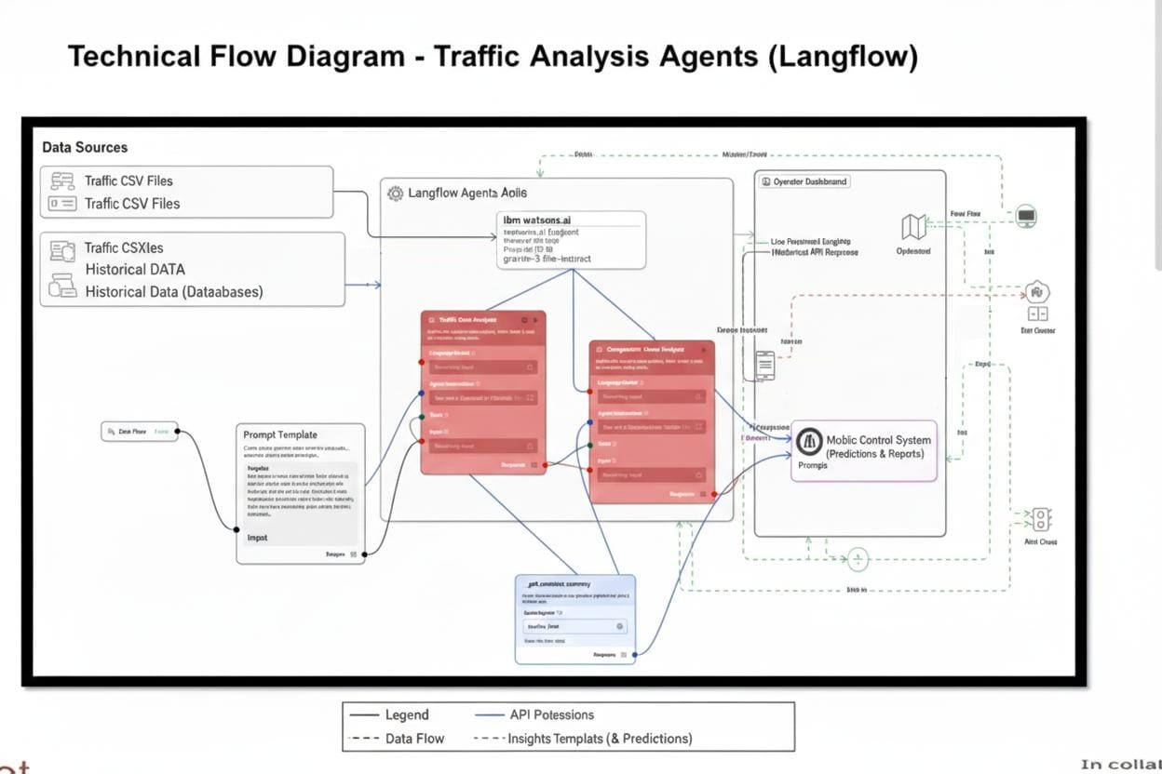
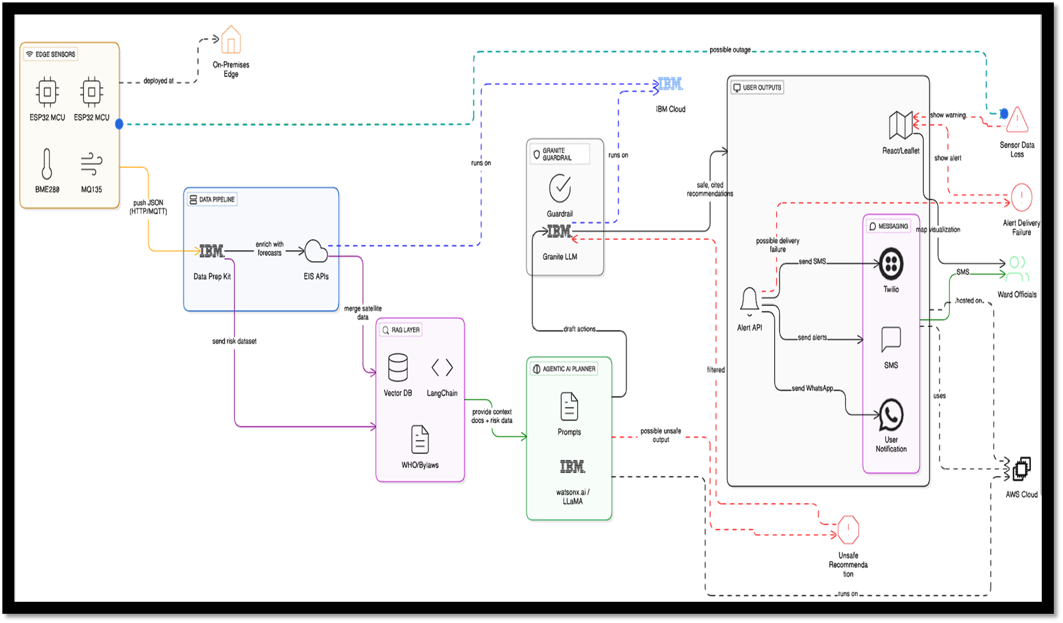
Technical flow diagram - Architecture blueprint

Slide 10
Langflow component Used
1) Chat Input
Receives user traffic queries from Playground
Entry point for natural language questions like "Why congestion at S4 during 8 AM?“
2) IBM watsonx.AI
Provides Granite 3-8B-Instruct model (8 billion parameters)
Configured with IBM Cloud API credentials
Powers all three agents with language understanding capabilities
3) Agent: Traffic Data Analyzer
Calls get_corridor_summary tool to read CSV data
Synthesizes traffic metrics: vehicle counts, speeds, signal timings
Outputs: Aggregated data summary to next agent
4) Agent: Congestion Cause Analyzer
Applies priority-based detection: Incidents → Weather → Demand → Signal → Bottleneck
Identifies PRIMARY cause with evidence
Outputs: Cause category and supporting metrics
5) Agent: Explainable Insight Assistant
Generates human-readable explanations using 9-category knowledge framework
Includes LOS theory, case studies (Stockholm, London, Singapore)
Outputs: Detailed explanation with recommendations
6) Python Interpreter (Tool Mode)
Reads traffic_corridor.csv (11 columns: timestamp, corridor, signal, counts, speed, weather, incidents)
Filters and aggregates data by corridor and signal
Returns JSON summary to agents
7) Prompt Template
Standardizes user queries with {input} variable
Adds analysis context and instructions
8) Chat Output
Displays final comprehensive analysis
Shows metrics, causes, explanations, and recommendations

Slide 11
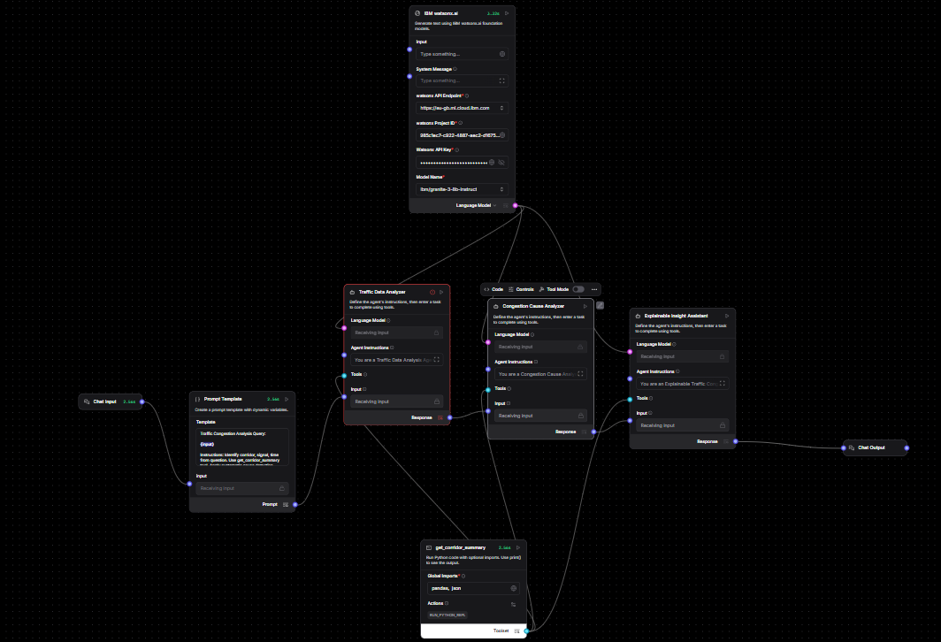
Input Screenshot 1

Slide 12
Input Screenshot 2

Slide 13
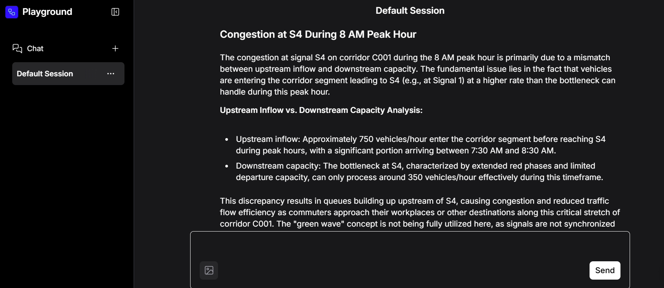
Output Screenshot 1

Slide 14
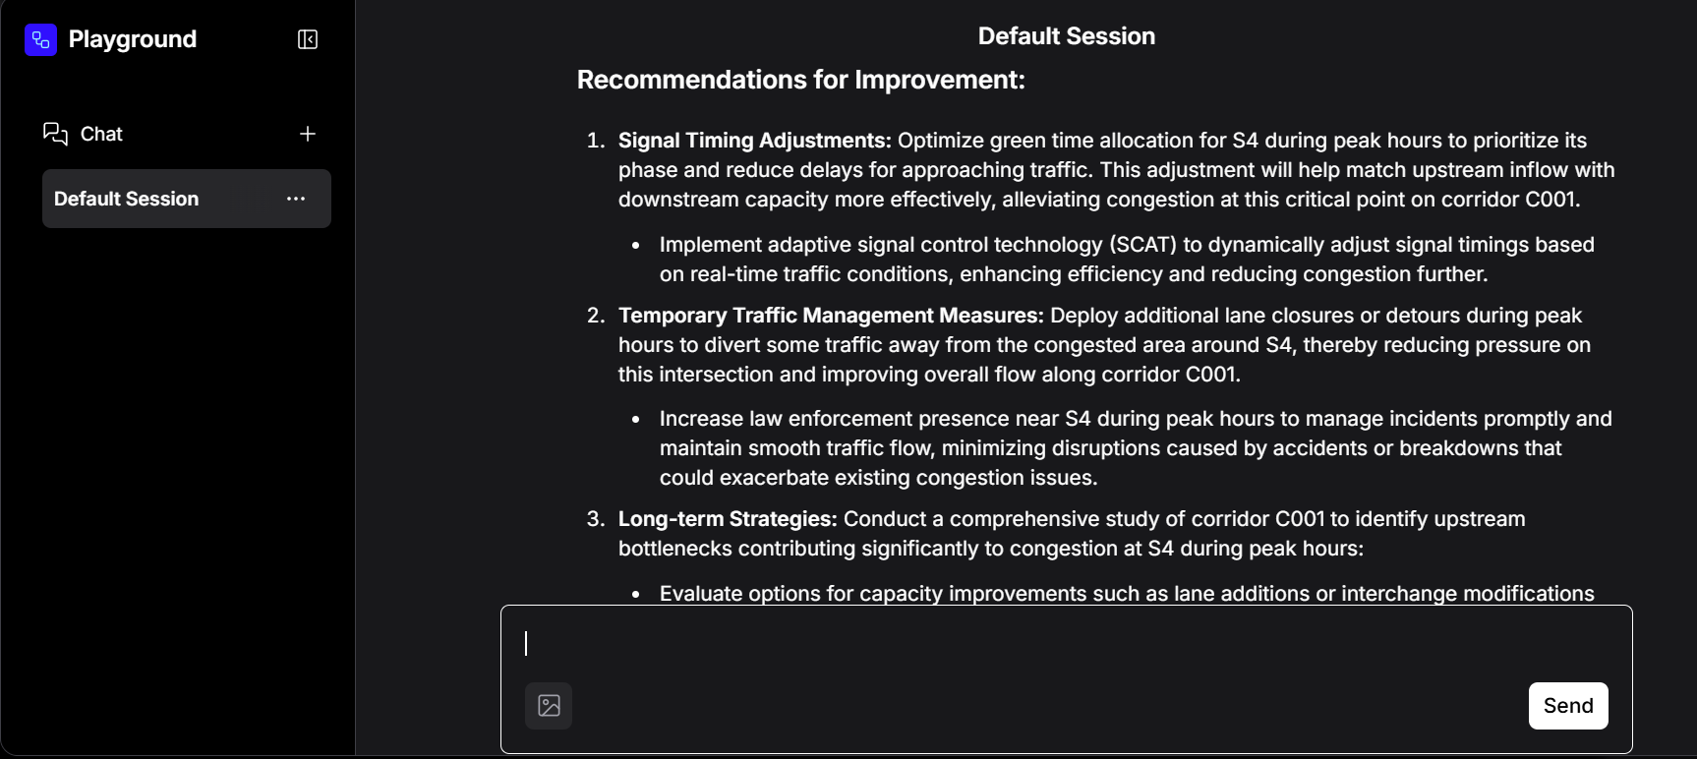
Output Screenshot 2

Slide 15
Future Scope
Real-time Integration - Connect to live traffic sensor APIs for real-time analysis
Predictive Modeling - Forecast congestion 30-60 minutes in advance
Multi-city Deployment - Extend to other cities (Mumbai, Delhi, Hyderabad)
Mobile Application - Develop commuter-facing app for real-time alerts
Automated Signal Control - Integrate with smart traffic light systems
Weather API Integration - Real-time weather data correlation
Advanced Visualization - Interactive dashboards with heat maps
Machine Learning Enhancement - Train custom models on Bengaluru traffic patterns
Incident Detection - Automatic accident/breakdown detection from data anomalies
Environmental Impact Analysis - Track CO2 emissions and air quality correlation
·
·

Slide 16
Git Hub Link
https://github.com/avanimanoria/Traffic_congestion.git
·
·
·

Slide 17
References
https://docs.langflow.org
https://docs.datastax.com/en/langflow/index.html
https://developers.google.com/maps/documentation/routes/traffic-opt
https://openweathermap.org/api
https://www.scitepress.org/Papers/2024/124519/124519.pdf
·
·
·

Slide 18


